Slide 1
CS209/CS210 COMPUTER ARCHITECTURE PROJECT TOPIC: ARDUINO BASED HAND GESTURE CONTROL SYSTEM
Submitted By:
Name: Bhavika Choudhary
Roll No.: 2101AI10
Submission Date: 02/12/2022

Slide 2
About Project
The project is about an Arduino-based hand gesture control system which identifies various hand gestures and perform functions related to them. Gesture control is the ability to recognize and interpret movements of the human body in order to interact with and control a computer system without direct physical contact. With the world developing at a speed unimaginable to mankind, we need smart systems which require less effort to operate.
This project, thus allows the users to remotely control and perform various functions on the computer system.

Slide 3
INTRODUCTION
In this project, I have used two ultrasonic sensors to detect any pulse generated by the object (in this case, our hand) which in turn returns the time taken for the pulse to travel back and forth by getting reflected by the object. This time taken is used to calculate the distance between the sensor and the object.
Now with this, at different distances, different gestures are taken into account and functions relating to them are performed.

Slide 4
Description
According to the Arduino code, it first calculates the distance between the object and the ultrasonic sensor and according to carious distances, different outputs are given in the Serial port.
This project uses Python to set the commands to be performed for various gestures.
The “Serial” output is read by Python’s pyserial module and different commands like pressing spacebar to play/pause video, pressing Crtl+right key to forward the video, and so on.

Slide 5

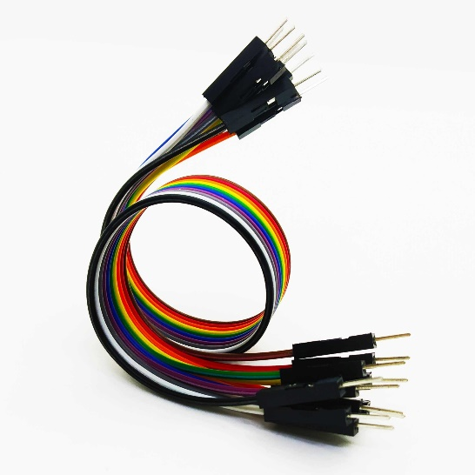
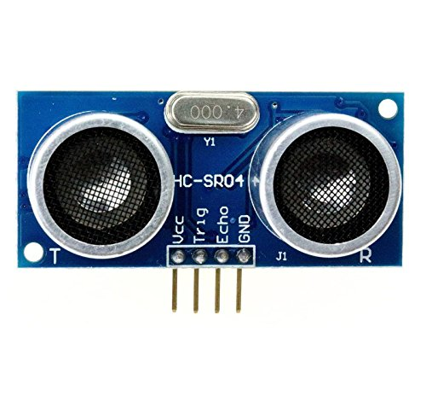
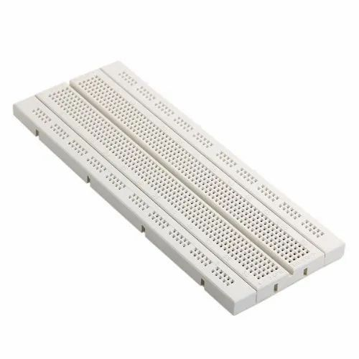
Components used
Jumper Wires, Breadboard
Arduino Uno R3
HC-SRO4 Ultrasonic Sensor

Slide 6
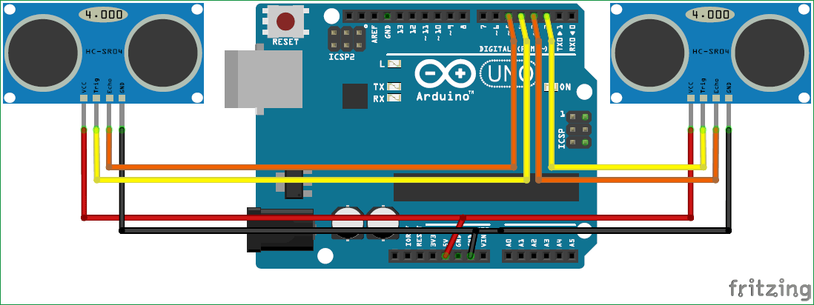
CIRCUIT DIAGRAM

Slide 7
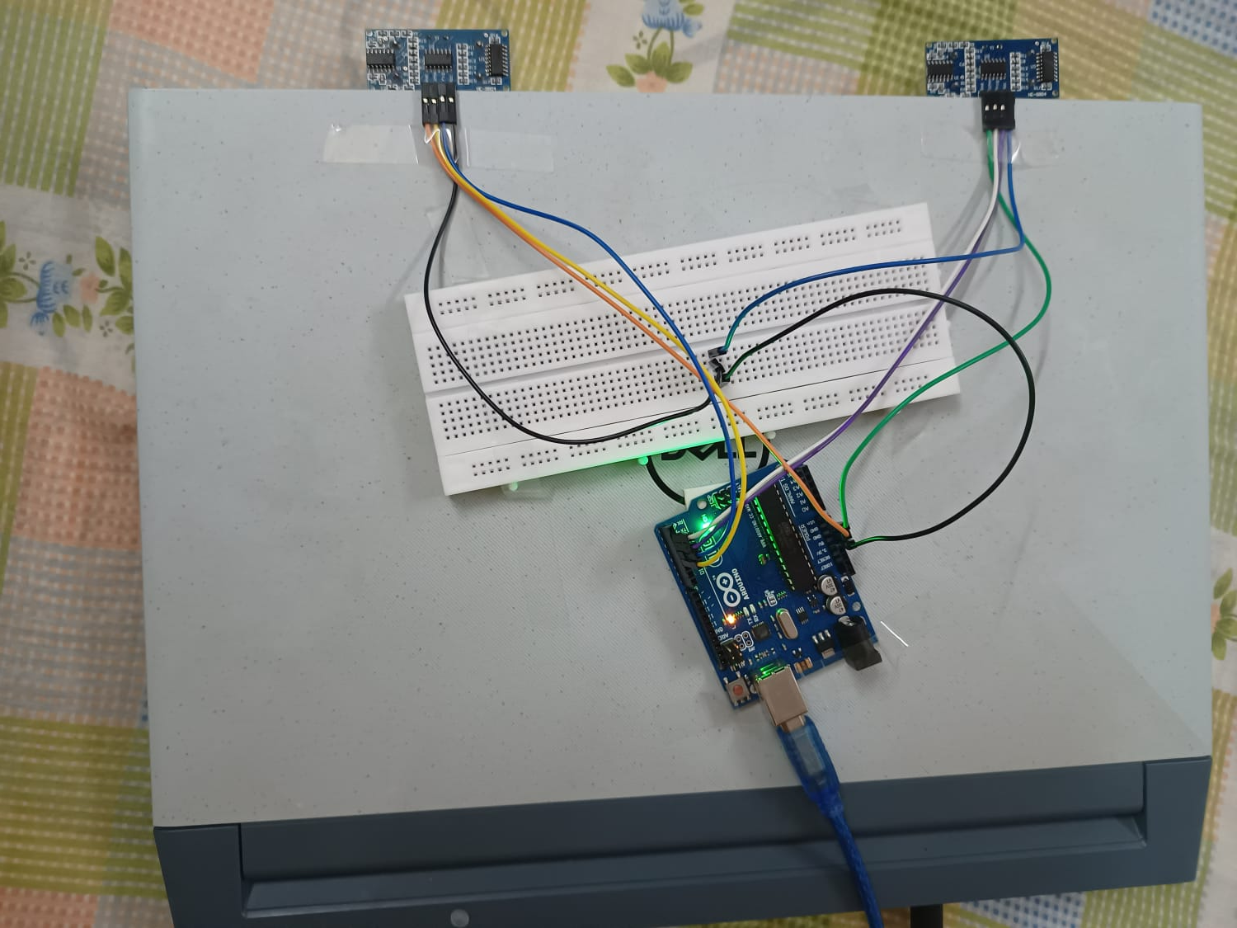
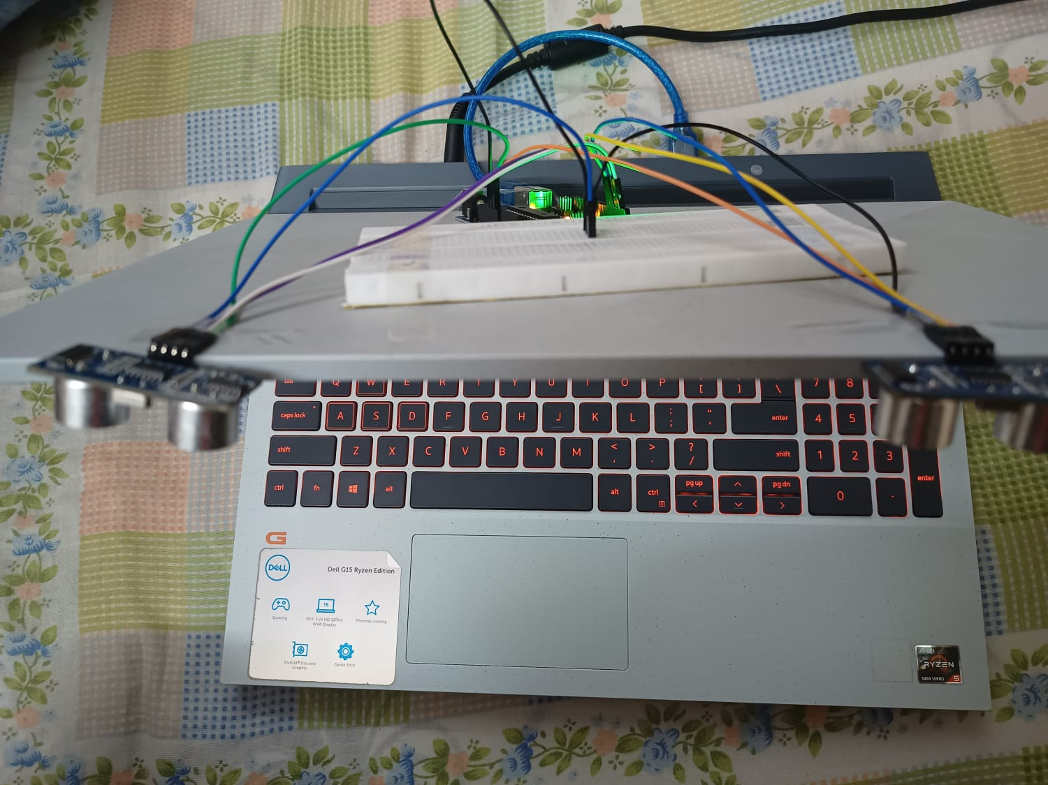
Full circuit Images

Slide 8
Connections
Trig Pin (Sensor 1) - D1 (Arduino)
Echo Pin (Sensor 1) - D2 (Arduino)
Trig Pin (Sensor 2) - D3 (Arduino)
Echo Pin (Sensor 2) - D4 (Arduino)
Gnd pin of both sensors – Gnd of Arduino
VCC pin of both sensors – 5V of Arduino

Slide 9
Functions and Hand gestures
Both hands in-front of sensors : Play/Pause Video
Right Hand in-front of right sensor: Right Locked
Right Hand pushed in: Rewind
Right Hand pulled away: Forward
Left Hand in-front of right sensor: Left Locked
Left Hand pushed in: Volume Down
Left Hand pulled away: Volume Up
Any hand put really close to sensor: Play Next in queue

Slide 10
Conclusion
With all this, I conclude my project of Arduino based Hand gesture control system which can be used to control your computer system remotely, hence reducing human physical effort
Thank you

